Slide 1
Equivocation & Amphiboly

Slide 2
Definition
Equivocation (semantic ambiguity)
The fallacy of attempting to demonstrate or support a point by playing on the ambiguity of an expression.
Example - A nova is when a star explodes. Chevy made novas in the 70's. Chevy exploded stars in the past.
Amphiboly (syntactic ambiguity)
The mistake of trying to demonstrate or support a point by playing on the ambiguity of an expression, where the ambiguity derives from the expression’s syntax.
Example - I found a cougar in my car.
Accent (emphasized ambiguity)
When the meaning of a sentence is changed by placing an unusual verbal emphasis or when, in a written passage, it is left unclear on which word the emphasis was supposed to fall.
Example - Frank gave a great speech today.

Slide 3

examples
Equivocation

Slide 4

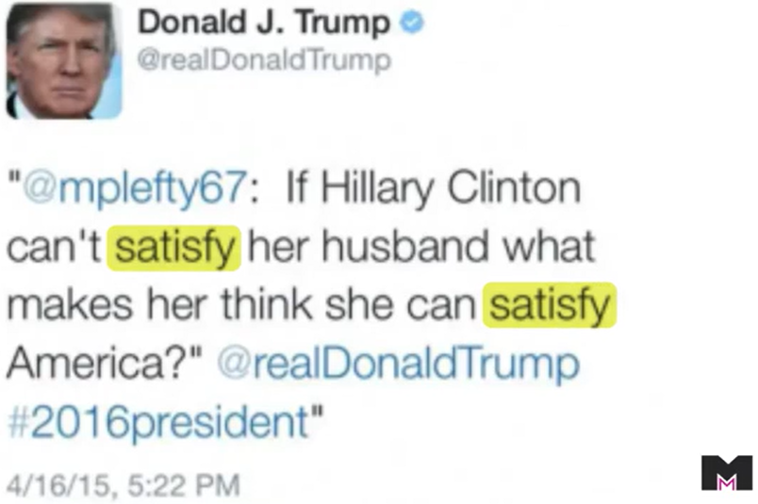
Equivocation
The 1% Club - S1E1 - June 3, 2024 70% Question: Wednesday, Will and Wanda went out to lunch. At the end of the meal, one of them paid the bill, but it wasn’t Will or Wanda. Who paid for lunch?

Slide 5
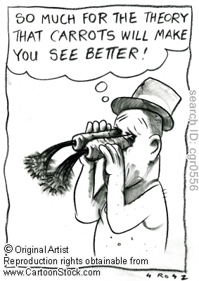
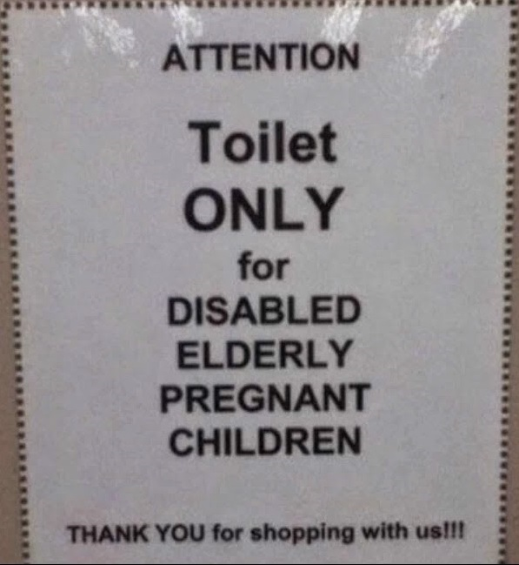
Amphiboly

Slide 6
How TO SPOT
Look for ambiguity in the argument/statement. Identify slang, pronouns/prepositions, and unstated parts of the statement.
The easiest form to spot is usually Equivocation, when a word/phrase has more than one meaning, including slang uses.
Determine if any pronouns or prepositions are ambiguous. Amphiboly often involves these.
Unstated/implied subjects/verbs/etc often allow the reader to fill in the blank with an incorrect assumption.

Slide 7
Effectiveness & Effect on the world
How effective these fallacies are lies almost entirely in the cleverness of the user versus the critical thinking and intellect of the listener.
The more subtle and crafty the ambiguity, the more likely the fallacy is to go unnoticed and, if intentional, serve its intended purpose.
These fallacies can be effective in communicating disagreeable messages.
Use of these fallacies is common in politics and advertising, where a statement's ambiguity and openness to multiple interpretations can allow a voter/consumer to hear what they want and/or allow the politician/company to weasel out of the statement later.

Slide 8

How to avoid
Clarity is key - Try to avoid ambiguity in words and sentence structure.
Avoid slang terms and unclear pronouns or prepositions.
Make sure there are no unstated subjects/verbs/etc.
Improve your personal dictionary; understanding a word’s possible meanings can help avoid confusion.
Remember that the ambiguity can be unintentional, so asking the speaker to clarify the meaning of a word, phrase, or sentence can sometimes resolve the fallacy.

Slide 9
References
Recognizing Fallacies/Fallacies of Ambiguity. (2022, November 25). In Wikipedia. https://en.wikiversity.org/wiki/Recognizing_Fallacies/Fallacies_of_Ambiguity
Equivocation Fallacy | Definition & Examples. (2023, July 24). https://www.scribbr.com/fallacies/equivocation-fallacy/
Family Guy Logical Fallacies: Equivocation. (2021, December 31). https://www.youtube.com/watch?v=mGCwPIU4iOs
The Equivocation Fallacy - Don't Do this in a Debate - featuring Donald Trump and Hillary Clinton. (2020, August 8). https://www.youtube.com/watch?v=1aryg2WJ570
The 1% Club Questions & Answers for Season 1 (2024). (2024, September 10). https://www.comingsoon.net/guides/features/1788741-1-percent-club-questions-answers-tonight-last-night-tv-show
Critical Thinking: Common Informal Fallacies, Part 2. (2013 February 14). https://craigssenseofwonder.wordpress.com/tag/amphiboly/
A funny Amphiboly. (2016, January 26). https://blogorganon.blogspot.com/2016/01/a-funny-amphiboly.html

